Slide 1
STRUCTURE OF A FOUR FOLD LESSON PLAN
Dr. NAMBARU MARY SUNEETHA
Assistant Professor
MEASI College of Education
No.2, Demellows Road, Choolai, Chennai-600112.

Slide 2
OBJECTIVES
Understand the steps in planning a lesson and setting lesson goals
Design a lesson plan
Understand Bloom’ s Taxonomy of Educational Objectives
Specification of Behavioural outcomes
Learning Experiences
Evaluation of self and the students
Analyse the structure of the lesson
Gain mastery in preparing a lesson plan
Select the Content to be used

Slide 3
INTRODUCTION
A teacher should concentrate on a wise planning of his teaching and instructional work carried along with his students during the whole session.

Slide 4
LESSON PLAN-Essential Factors
Knowledge about the needs,
Interests and abilities of the students,
The knowledge of psychology of learning,
Principles of teaching,
Previous knowledge of the students, and
Effective mastery of the subject matter

Slide 5
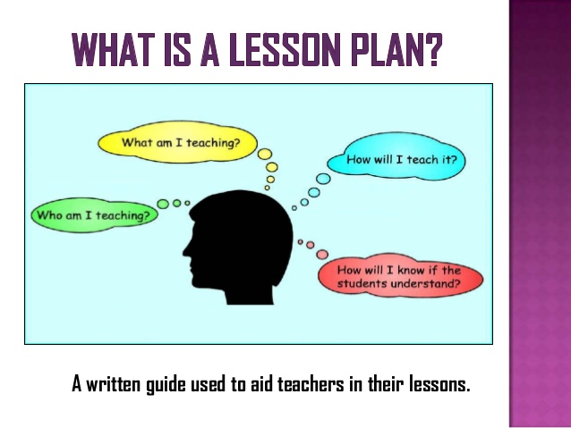

Slide 6
DEFINITION OF LESSON PLAN
Bossing defines, “A lesson plan is an organized statement of general and specific goals together with the specific means by which these goals are to be attained by the learner under the guidance of the teacher on a given day.”

Slide 7
HERBARTIAN STEPS OF LESSON PLAN
Preparation or Introduction
Presentation
Comparison or Association
Generalization
Application and
Recapitulation

Slide 8
STEP-1 Preparation or Introduction
Testing the previous knowledge of the students
Arousing curiosity by the novelty of experimentation or activity
Use of charts, pictures and models
Skillful discussion
This is most important step because “well-begun” is
half done.”

Slide 9
Step-2 Presentation
The teacher presents the subject matter to the students. Students get new ideas and knowledge.
The students passively listen and learn the ideas told by the teacher.
The teacher may demonstrate any experiment, use any teaching aid or do any activity/activities.

Slide 10
Step-3 Comparison or Association
The new ideas or knowledge learnt should be compared and associated with already known ideas and facts.
This step is most important when the teacher is establishing principles or generalizing definitions.

Slide 11
Step-4 Generalization
Students should draw out the conclusion themselves.
Their generalizations may be incomplete or irrelevant.
At this time the teacher should guide them to make corrections.

Slide 12
Step-5 Application
Any lesson will be incomplete if the past experience is not applied to new life situations.
It is always the desire of the students to make use of generalizations and to verify whether they really work in new situations.
Knowledge becomes clear and meaningful in this stage.

Slide 13
Step-6 Recapitulation
It is generally done by one of the following ways:
Asking suitable questions on the topic taught /
Applying a short objective type test /
Asking the students to label the unlabeled sketch/diagram/picture

Slide 14
ADVANTAGES OF LESSON PLANNING
Regular, well organized and systematic work
Prompts confidence and self-reliance
Helps to proceed with particular aims in view
Establishes proper connections between different lessons of study
Therefore, they provide continuity in the teaching process

Slide 15
ADVANTAGES OF LESSON PLANNING
Stimulates the teacher to introduce striking questions and illustrations
Provides greater freedom in teaching
Helps the teacher to plan the teaching aids to be used in the class, well in advance and also ensure their workability
Avoids wastage of time

Slide 16
CRITERIA OF A GOOD LESSON PLAN
A lesson plan should be written and well prepared assuming that teacher has gone through the matter from all aspects
General Objectives also called non-behavioural objectives of the lesson should be clearly stated
Specific objectives also called behavioural objectives should be clearly stated
Types of teaching aids should be selected according to the situation
Content, learning experiences, evaluation tools and procedure should be stated

Slide 17
STRUCTURE OF A FOUR FOLD LESSON PLAN
Structure of a Lesson Plan
1.Content
2.Specification of behavioural objectives
3. Learning Experience
4. Evaluation

Slide 18
MODEL LESSON PLAN IN ECONOMICS
Name of the School: X
Standard: XI
Subject: Economics
Topic: Course of Price
Name of the Student: X
Name of the Guide Teacher: X
Date: X
Time: 45 Minutes

Slide 19
INSTRUCTIONAL OBJECTIVES
The student:
Recalls and recognizes the economic problems of the price rise in India.
Understands the relationship between prices and purchasing power of money.
Compares the prices of different commodities from time to time and from place to place.
Explains the effect of rising price on the growth and development of an Economy.
contd…..

Slide 20
INSTRUCTIONAL OBJECTIVES
The student:
Lists out the various types of indicators of price trend
Examines the necessity of revising trend of prices
Classifies various causes of price rise
Illustrates the course of prices and various types of policy measures taken by the government
contd….

Slide 21
INSTRUCTIONAL OBJECTIVES
The student:
Understands the place given to the problem of rising prices in various plans
Explains about the need for price stability.
Analyses the situation of price rise and also various policy measures taken by the government.
Develops skill in drawing inference about forthcoming price rise problem due to recent oil price rise.

Slide 22

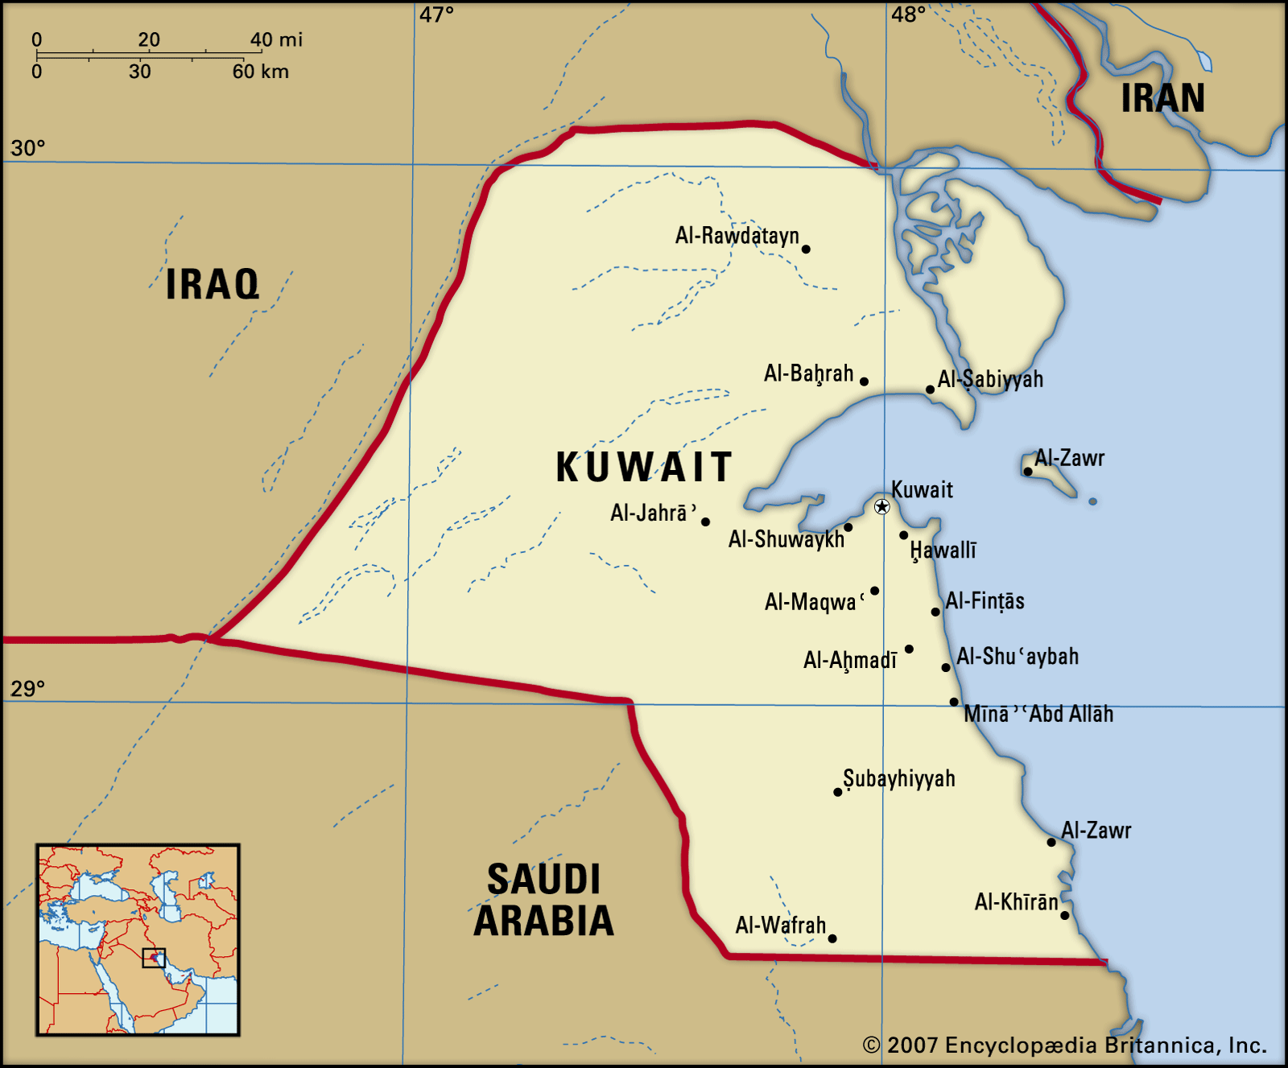
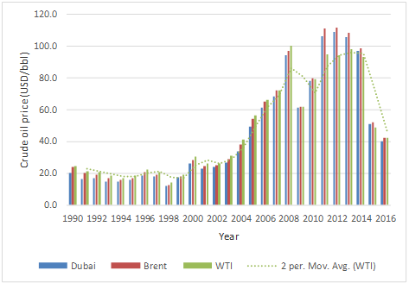
Teaching Aids:
Charts,
graphs,
Pictures showing price rise in India

Slide 23
Previous Knowledge of the Students:
International problem of rising price of crude oil
(Details have been given in the following slide)

Slide 24
MODEL LESSON PLAN IN ECONOMICS
CONTENT | SPECIFICATION OF BEHAVIOURAL OUTCOMES | LEARNING EXPERIENCES (Teacher/Learner Activities) | EVALUATION
On August 2, 1990, Iraqi armed forces invaded state of Kuwait. This event gave rise to an international economic problem of rising price of oil. Due to this, the prices of other commodities also rise. | Recalls and recognizes | The student recalls the previous knowledge of international economic problem | Contd...

Slide 25
MODEL LESSON PLAN IN ECONOMICS
CONTENT | SPECIFICATION OF BEHAVIOURAL OUTCOMES | LEARNING EXPERIENCES (Teacher/Learner Activities) | EVALUATION
 |  | Iraqi occupation of Kuwait gave rise to which international economic problem? What is the implication of rising transport cost on the prices of the commodities?

Slide 26
MODEL LESSON PLAN IN ECONOMICS
CONTENT | SPECIFICATION OF BEHAVIOURAL OUTCOMES | LEARNING EXPERIENCES (Teacher/Learner Activities) | EVALUATION
Course of prices: Price mechanism has a significant place in a planned economy. Changes in prices bring changes in the purchasing power of money also. | Understands | Student understands the relationship between prices and purchasing power of money. | What do you mean by purchasing power of money?

Slide 27
MODEL LESSON PLAN IN ECONOMICS
CONTENT | SPECIFICATION OF BEHAVIOURAL OUTCOMES | LEARNING EXPERIENCES (Teacher/Learner Activities) | EVALUATION
Course of prices: Price mechanism has a significant place in a planned economy. Changes in prices bring changes in the purchasing power of money also. | Explains | Student explains the effect of rising price on the growth and development of an economy. | What happens to the purchasing power of money when the prices rise?

Slide 28
MODEL LESSON PLAN IN ECONOMICS
CONTENT | SPECIFICATION OF BEHAVIOURAL OUTCOMES | LEARNING EXPERIENCES (Teacher/Learner Activities) | EVALUATION
At high prices money commands lesser commodities and at lower prices more commodities. | Compares | Student compares the prices of different commodities from time to time and from place to place. | Rising of price of petrol affected which sector of economy directly?

Slide 29
MODEL LESSON PLAN IN ECONOMICS
CONTENT | SPECIFICATION OF BEHAVIOURAL OUTCOMES | LEARNING EXPERIENCES (Teacher/Learner Activities) | EVALUATION
Rising in oil prices economically hit international community. | Explains | Student explains the effect of rising price on the growth and development of an economy. | What is the effect of rising price on the growth and development of an economy?

Slide 30
MODEL LESSON PLAN IN ECONOMICS
CONTENT | SPECIFICATION OF BEHAVIOURAL OUTCOMES | LEARNING EXPERIENCES (Teacher/Learner Activities) | EVALUATION
Indicators of Price trends | Lists out | Lists out the various types of indicators of price trends. Defines the word deflation. | What do you mean by Inflation?

Slide 31
MODEL LESSON PLAN IN ECONOMICS
CONTENT | SPECIFICATION OF BEHAVIOURAL OUTCOMES | LEARNING EXPERIENCES (Teacher/Learner Activities) | EVALUATION
Trends of Prices in India | Examines | The student examines the necessity of revising trend of prices in order to understand nature and complexity of the problem. | The rising trend of prices in India started at what time?

Slide 32
MODEL LESSON PLAN IN ECONOMICS
CONTENT | SPECIFICATION OF BEHAVIOURAL OUTCOMES | LEARNING EXPERIENCES (Teacher/Learner Activities) | EVALUATION
Second world war leads to the trend of price rise | Classifies | The student classifies various causes of price rise. | What was the reason for price rise?

Slide 33
MODEL LESSON PLAN IN ECONOMICS
CONTENT | SPECIFICATION OF BEHAVIOURAL OUTCOMES | LEARNING EXPERIENCES (Teacher/Learner Activities) | EVALUATION
Immediately after independence the Government formulated various economic policies | Illustrates | The student illustrates the course of prices and various types of policy measures taken by the government. | When the economic planning was adopted in India?

Slide 34
MODEL LESSON PLAN IN ECONOMICS
CONTENT | SPECIFICATION OF BEHAVIOURAL OUTCOMES | LEARNING EXPERIENCES (Teacher/Learner Activities) | EVALUATION
Economic planning in India began on an optimistic note. | Understands | The student understands the place given to the problem of rising prices in various plans. | A rupee of 1969 is worth only 11 paise presently. Why?

Slide 35
MODEL LESSON PLAN IN ECONOMICS
CONTENT | SPECIFICATION OF BEHAVIOURAL OUTCOMES | LEARNING EXPERIENCES (Teacher/Learner Activities) | EVALUATION
Domestic supply situation was favourable and could easily meet the rising demand pressure | Explains | The teacher explains that every plan has been eloquent about the need for price stability. | What happened to the general price index?

Slide 36
REVIEW/RECAPITULATION
What is the effect of rising price on the growth and development of an economy?
What do you mean by GDP?
The rising trend of prices in India started at what time?
What was the reason for price rise?
When the economic planning was adopted in India?
What happened to the general price index?

Slide 37
ASSIGNMENT/FOLLOW UP ACTIVITIES:
1.Trace in brief the trend of prices in India beginning with first five year plan.
2. Describe about the general price index.
Name of the Guide Teacher Name of the Student Teacher

